Slide 1

Nature Hub
Akhilesh Tripathi
Aaditya Srivastava
Akriti Singh
Simran Pandey

Slide 2
Introduction
What is Nature Hub?
Nature Hub is an innovative web application aimed at promoting natural and sustainable living. It merges three key areas:
Natural Remedies: A curated collection of herbal and home-based solutions for common health problems.
Holistic Health Practices: Guides and tips focused on improving overall well-being through simple lifestyle changes.
Eco-Friendly Product Shopping: A platform for purchasing environmentally sustainable products.
Purpose:
The project was designed to bridge the gap between modern convenience and traditional wellness practices. It empowers users to make informed decisions about their health and lifestyle, fostering a connection with nature.
Unique Selling Point (USP):
Unlike other platforms that focus solely on e-commerce or health blogs, Nature Hub integrates remedies, health advice, and shopping into one cohesive solution.

Slide 3




Tools and Technology :
Database:
SQL Server 2022 serves as the relational database to store and manage all platform data.
Backend:
Developed using C# and .NET Core 8.0 to:
Implement APIs for handling user requests and returning data.
Manage business logic for user activities, product transactions, and remedy storage.
Provide seamless communication between the database and frontend.
Frontend:
Angular (v17.3.11) ensures a dynamic and user-friendly interface.
HTML5 structures the web pages.
CSS3 and Bootstrap5 add styling for responsiveness and a polished design.
Testing Tools:
Swagger: Documents all API endpoints, allowing developers to test functionality directly.

Slide 4





Project Modules
We divide the project into five Modules. The Modules are as follows :-
User Module
Admin Module
Heath Tips Module
Remedies Module
Products Module

Slide 5




Admin Module
The Admin Modules Contains the following sub-modules :-
Delete Users
CRUD in Health Tips
CRUD in Remedies
CRUD in Products

Slide 6





User Module
The User Modules Contains the following sub-modules :-
Login/Sign Up
Payments
Bookmarks
Add to cart
Addresses

Slide 7
Health Tips Module
Designed to educate users with short, impactful tips for improving health.
Examples:
Hair Care: “Rinse hair with apple cider vinegar for added shine.”
Skin Care: “Apply honey and cinnamon paste to reduce acne.”
Immunity Boosting: “Include more vitamin C-rich foods like oranges and kiwis.”
Search and Filter Options: Helps users find remedies based on their specific needs or symptoms.
User can filter this by category and category are as follows :-
Hair
Body
Digestion
Immunity
Skin

Slide 8
Product Module
Product Listings include detailed information such as product name, description, price, and eco-certification. Users can view multiple products, sort them by categories (e.g., skincare, home essentials), and search for specific items.
The Add to Cart Functionality enables users to select desired items, update quantities, and remove products before purchase. A summary of selected items with total costs is displayed in the cart for convenience.
The Checkout System streamlines the payment process, providing users with options to finalize their orders. Once an order is placed, it’s stored in the database for tracking and user reference.

Slide 9
Remedies Module
A key feature that promotes natural healing by offering:
Detailed Remedy Information: For instance, remedies like aloe vera gel for burns, chamomile tea for stress, etc.
Interactive Features: Users can save remedies as Bookmarks.
In this we have :-
Benefits
Usage
description
Preparation

Slide 10
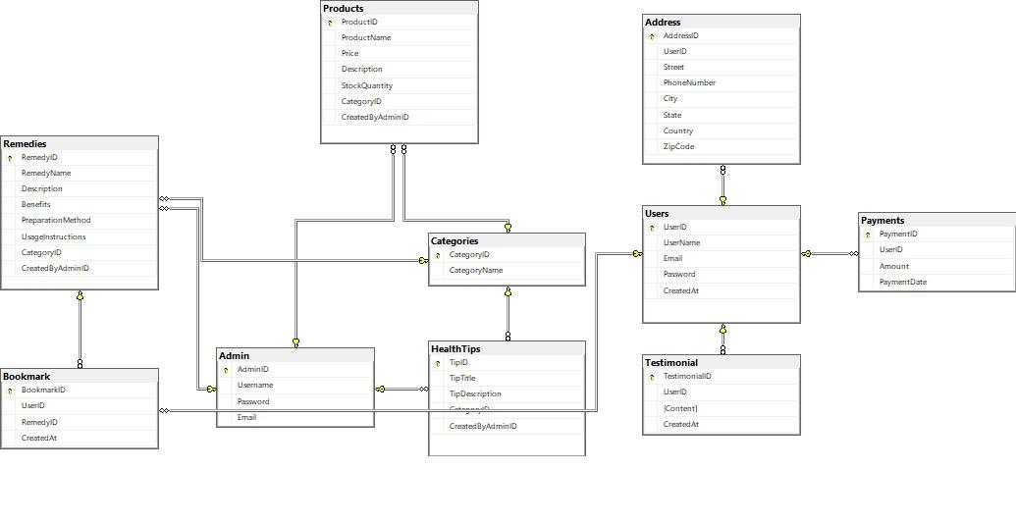
ER DIAGRAM

Slide 11
Conclusion
Nature Hub combines tradition and technology to provide a unique wellness solution.
It addresses modern health challenges by encouraging eco-friendly habits and natural living.
The project’s user-friendly interface, comprehensive features, and robust backend ensure long-term usability and scalability.
Innovative Features: The platform includes a Remedy Module, Health Tips Module, Shopping Module, User Dashboard, and Admin Panel.
User-Centric Design: With tools like personalized dashboards, bookmarks, and intuitive navigation, Nature Hub ensures a seamless experience for users.
Sustainability Focus: Offers eco-conscious products, encouraging environmentally responsible choices.
Scalable Technology: Built using SQL Server, .NET Core, and Angular, the platform is reliable, scalable, and future-ready.
Holistic Wellness: Provides an all-in-one solution for health improvement, natural remedies, and eco-friendly shopping.

Slide 12
Thank you

